Slide 1




MEET THE TEACHERS
YEAR 3

Slide 2

WILLOW CLASS
HOLLY CLASS
Teachers: Miss Guthrie and Mrs Jacks (from Easter)
TA: Miss Dal Mas
PPA Cover: Mrs S and Mrs Chaffe (until Easter)
Teacher: Miss Coleman
TA: Mrs Clarson
PPA Cover: Mrs Kalinka

Slide 3






COMMUNICATION
School Comms (MCAS, Arunside Announcements)
But, please feel free to come and speak to us at the end of the day, leave a message for us at the school gate, or if you to speak to us for a little bit longer, please call or email to make an appointment.
Year 3 page on Arunside website
Email office@arunside.school
Reading records (Tuesday and Friday)

Slide 4
WHAT DO WE LEARN ABOUT IN YEAR 3?
Autumn Term - Ancient Egypt
Spring Term - Rainforests
Summer Term - Stone Age to Iron Age

Slide 5
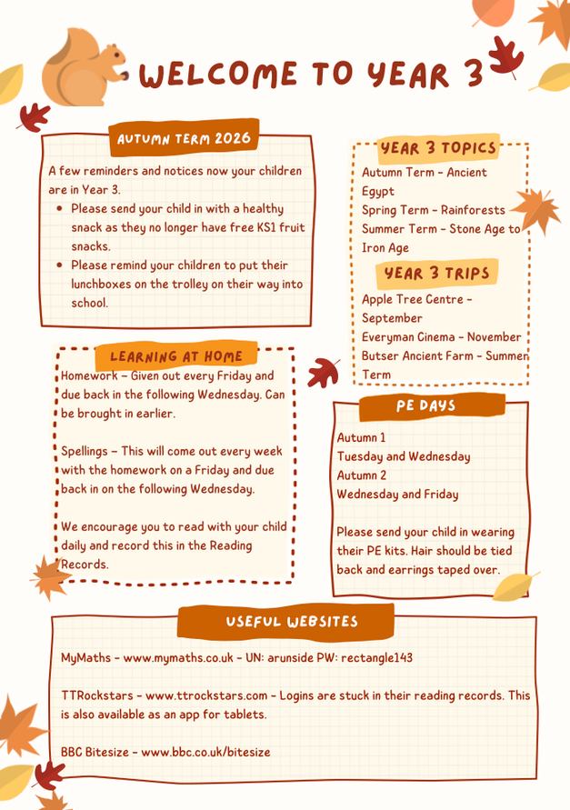
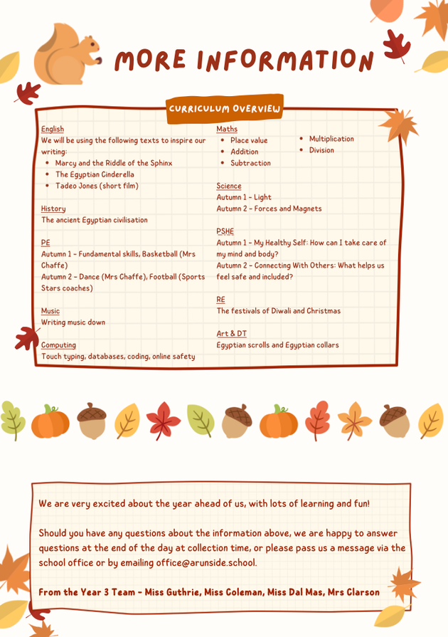
YEAR 3 NEWSLETTER

Slide 6
WHAT TRIPS WILL WE GO ON?
Apple Tree Centre (Hindu place of worship), Crawley - September 2026 - already sent out
Everyman Cinema, Horsham - November 2026 - details to come
Butser Ancient Farm, Waterlooville - Summer Term 2027 - details to come

Slide 7
READING, HOMEWORK AND SPELLINGS
Reading needs to happen every day, even if it is a different book from the one at school. You can take turns to read if it is a more challenging book, but please cultivate that love of reading! Reading skills underpin all other learning and future development!
Homework – Given out every Friday and due back in the following Wednesday. Can be brought in earlier. After feedback from parents last year, this will be on paper rather than on Purple Mash, and will be a reading, writing or spelling task that will support our learning in the classroom.
Spellings – This will be more of an activity than a list of words to read, as we want to support children in understanding how to spell words. This will come out every week with the homework on a Friday and due back in on the following Wednesday.

Slide 8






WHAT ELSE CAN I DO TO SUPPORT MY CHILD’S LEARNING AT HOME?
Hear them read each day and write in their reading record.
Learn to read and write the Year 3 and 4 Common Exception Words.
Go to the Library.
Learn weekly spelling rules.
Complete homework each week.
Learn times tables and division facts for 2, 5, 10, 3, 4 and 8 times tables – practice regularly on TTRockstars!

Slide 9
HOW DO WE CELEBRATE YOUR CHILDREN?
Housepoints
Stickers
Daily celebration of our Very Important Person
Wonder Wall celebration assemblies
Visits to Mrs Jagger and Ms Broadhurst to show off our amazing learning

Slide 10





WHAT DOES MY CHILD NEED TO BRING TO SCHOOL EACH DAY?
A waterproof coat or jacket
Reading book and record
Water bottle
A healthy nut-free snack
Lunchbox if not having school dinners
Please remind your child to put these on the trolleys when you drop them off.

Slide 11
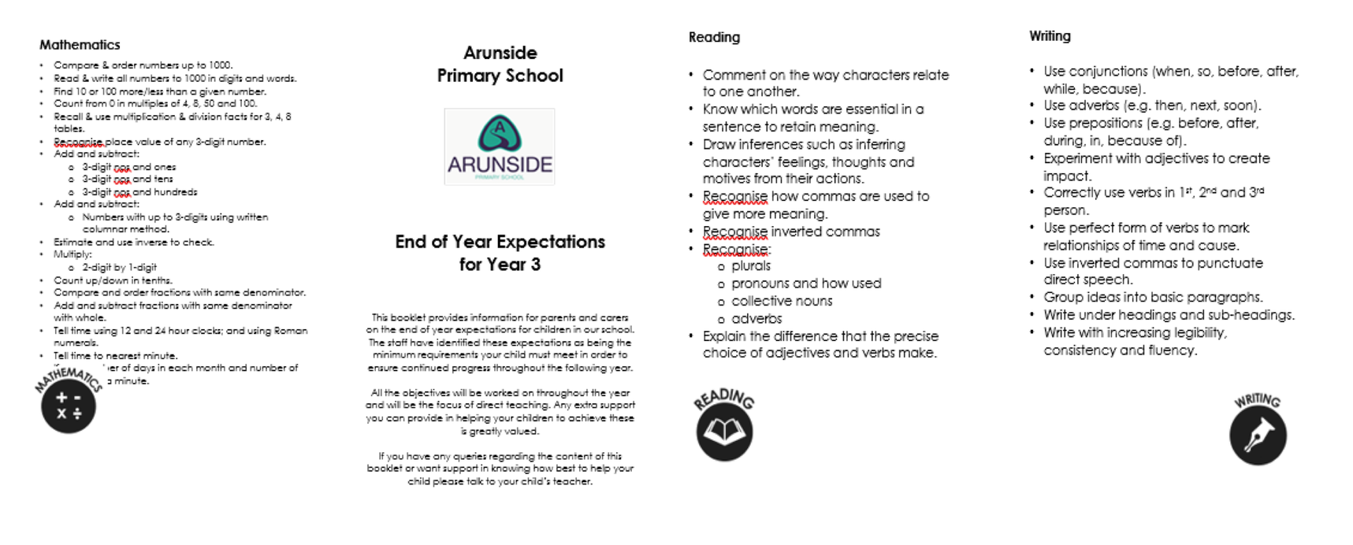
YEAR 3 END OF YEAR EXPECTATIONS

Slide 12


Slide 13
A COUPLE OF REMINDERS...
  Please update your permissions (e.g. photos, copyright, local walks). For details, please check emails/MCAS.
  If your child needs medication at school, please ensure all paperwork for this is up to date and that you have checked expiry dates.

Slide 14
THANK YOU FOR COMING!
We hope this has been useful.
Please let us know if you have any further questions.
Don’t forget to take a copy of the Year 3 end-of-year expectations and the Year 3 and 4 common exception words.

