Slide 1


Welcome to Year 1
2026-2027
Mrs Manger in Bluebell and Miss Booth in Poppy
TA support: Mrs Clive, Mrs Pedicini and Mrs Martin
PPA cover and Leadership: Mrs Livanos and Mrs Sofoglou.

Slide 2

Year 1 Topics
Autumn Term – Changes, specifically toys.
Spring Term – Around the World.
Summer Term – Castles, Kings and Queens.
We also focus a lot on the different seasons throughout the year.

Slide 3
Transition
Children can find it quite challenging to transition from Early Years Foundation Stage into the National Curriculum so we try to do it gradually throughout the first half of the autumn term.
A lot more is expected of them, but we try to make it as easy for them as we can. We continue to teach phonics, maths, reading and writing every day. We do this through whole class input on the carpet, then we work in small groups, where some children will be working with an adult, while others independently. We do have time for play, but it does get less frequent as the year moves on.

Slide 4
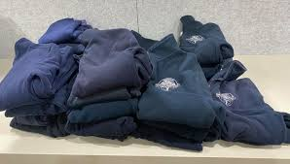
Name Labels
Please name all items of clothing with your child’s name. Children will take off jumpers and leave them anywhere. They fall off pegs and get moved around.

Slide 5
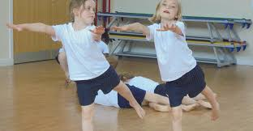
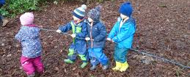
PE and Forest School
PE is on Monday and Friday this term but will change days as the year goes on.
Forest school is on Thursday.
Poppy Class are this half term and Bluebell Class are after half term.
Please make sure children have suitable clothing.

Slide 6

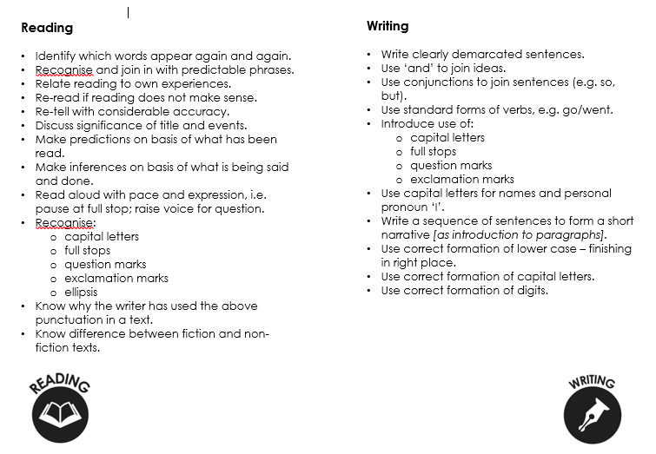
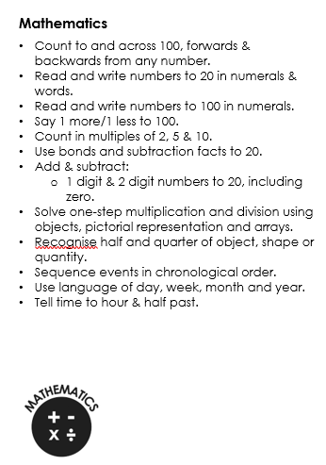
Year 1 end of year expectations

Slide 7

Reading
Reading books should be in school every day.
We check reading diaries on Tuesdays and Fridays, and provided that the diary has been signed, we change their reading books on these days too.
Please do try and read with your child every single day – reading is truly is the foundation to all their learning.
The Government guidelines are that children should read their phonic books 3 times which is why we only change them twice a week.
Please feel free to read other books you may have at home too.

Slide 8
Key Learning in Reading in Year 1
Match graphemes to phonemes.
Read accurately by blending sounds.
Read tricky words.
Read words with common suffixes: -ing, -ed, -est, -er.
Read contractions and understand their purpose.
Link to own experiences.
Join in with predictable phrases.
Discuss the text, including the title.
Make simple predictions.
Reading in school
The children get an opportunity to read their phonic books in school too, but most children are only heard 1:1 about once a week.
We also do whole class reading sessions (starting soon), where we read a page or 2 each time as a whole class and then answer questions based on it.

Slide 9

Reading in school
The children get an opportunity to read their phonic books in school too, but most children are only heard 1:1 about once a week.
We also do whole class reading sessions (starting soon), where we read a page or 2 each time as a whole class and then answer questions based on in. These books are ones that are slightly more challenging and offer a richer vocabulary and gives them an opportunity to discuss their ideas and show understanding of the text.

Slide 10

Phonics
Phonics is taught every day for about 30 mins. It is a mixture of reading and writing.
We usually mix up the classes for phonics and some children will work in a smaller group to make it easier for them.
We are currently revisiting Phase 3 and 4 and in a couple of weeks' time, we begin learning the new graphemes in Phase 5.
The Year 1 phonics check takes place in May/June and is a reading test only of 40 words – a mixture of real words and alien words.

Slide 11

Writing in Year 1
Name letters of the alphabet
Spell common exception and tricky words
Spell days of the week
Use common prefixes and suffixes
Compose sentences orally before writing
Read own writing to peers or adults
Write sentences with capital letters, full stops, question marks and exclamation marks
Write simple stories
Form letters correctly

Slide 12
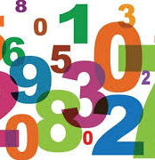
Maths in Year 1
Read, write and count numbers up to and across 100.
Counting in multiples of 2, 5 and 10.
Read and write numbers 1 – 20 in words.
Identify more, less and equal to when comparing numbers.
Adding and subtracting within 20 – using number bonds.
Solve missing number problems e.g. 7 = ____ - 9
Begin to solve one step multiplication and division problems.
Identify half and quarter.
Compare units of measurement.
Tell the time to the hour and half past the hour.

Slide 13

Homework will be handed out shortly once the children are all settled into their new routines of Year 1.
It is an opportunity for children to practise their learning at home too.
It will be a mixture of phonics, reading, writing and maths.
Homework will be given out on a Wednesday and to be returned the following Monday.

Slide 14
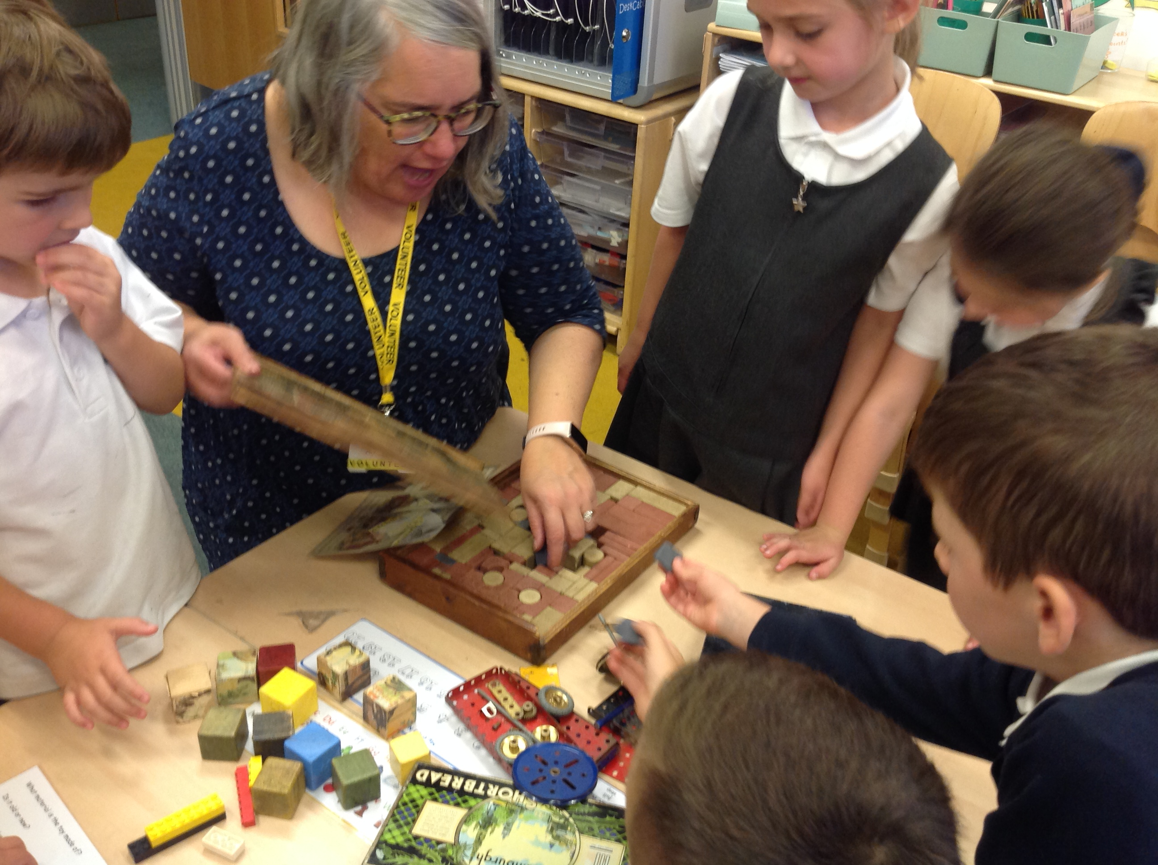
Enrichment
A visit from Horsham Museum - Toys Workshop in October.
A visit from Kingdom of Faith Church at Christmas time.
Visit to Arundel castle in the Summer term.

Slide 15


Slide 16


Parent Helpers
If you have any spare time and would like to come in and listen to children read, we would be much appreciative.
You would need to get a DBS check, which the lovely ladies in the office can help you with.
Afternoons are always good for us or first thing in the morning before our main lessons begin.

