Slide 1

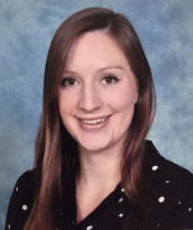
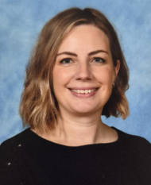
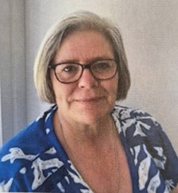
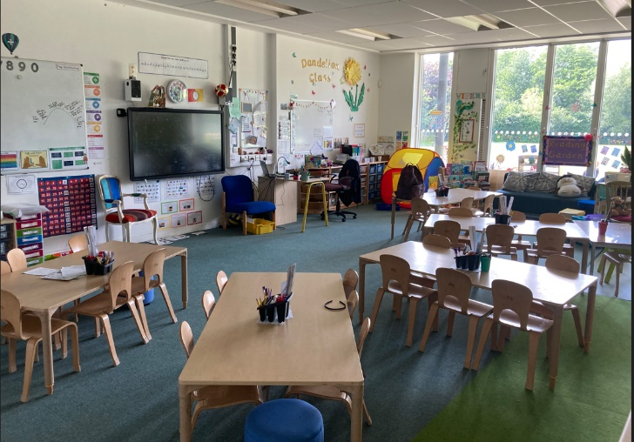

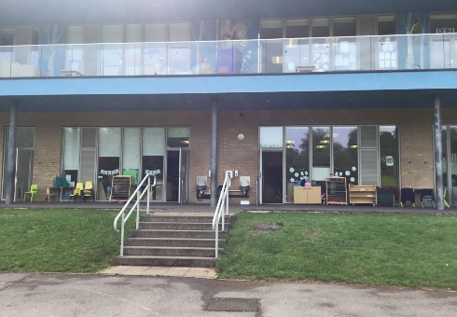
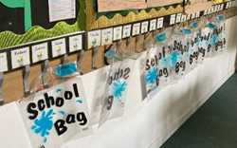
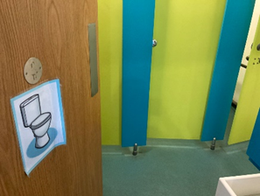
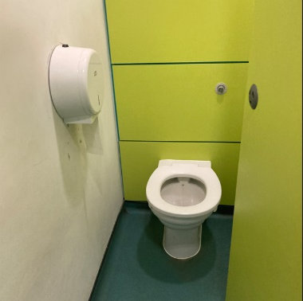
Next year I am going to be in Dandelion class.
My teachers will be:
Also helping me is:
Mrs Goldsmith
Mrs Edwards
Mrs McGeown
Here is a picture of my new classroom.
This is where I will enter the classroom in the morning.
This is where I will hang my bag and coat.
Here are the toilets.

