Slide 1
Welcome to Year 3: Meet the Teachers
Miss Booth and Mrs Rutherford
Willow
Miss Higman
Holly

Slide 2
Who works in Year 3?
Willow Class
Mrs Rutherford – Monday, Tuesday and alternate Wednesdays
Miss Booth – Thursday and Friday
Mrs Kalinka - alternate Wednesdays
Mrs Clive: Teaching Assistant – 5 mornings
Holly Class
Miss Higman – Monday, Tuesday, Wednesday, Thursday pm and alternate Fridays
Mr Heath – Thursday am
Mrs Kalinka – alternate Fridays
Mrs Fletcher: Teaching Assistant – 5 days
Afternoon interventions will take place in the afternoons with Teaching Assistants when necessary.

Slide 3
How will we communicate with you?
School Comms
Year 3 Page on Arunside Website
Email
office@arunside.school
Reading Records

Slide 4
What trips/visitors will we be happening this year?
Autumn Term – Horsham Museum & Hindu Temple
Summer Term – Butser Farm

Slide 5
What are the topics this year?
Autumn Term
Ancient Egypt
Spring Term
The Rainforest
Summer Term
Stone Age to The Iron Age

Slide 6
YEAR 3 NEWSLETTER
Year 3 Newsletter

Slide 7
What can I do to help my child at home?
Hear them read and write in the reading record each day.
Learn to read and write the Year 3 and 4 Common Exception Words
Go to the Library
Use the websites we suggest to support school learning at home.
Learn weekly spellings
Complete homework each week
Learn times tables and division facts for 2, 5, 10, 3, 4 and 8 times tables

Slide 8
What online ‘Learning platforms’ can I use to help my child?
Espresso https://www.discoveryeducation.co.uk/
Language Angels https://www.languageangels.com/schools/
MyMaths https://www.mymaths.co.uk/
Times Table Rockstars https://ttrockstars.com/
Purple Mash https://www.purplemash.com/sch/arunside

Slide 9
How will my child be rewarded for their efforts?
House points / Dojos
Wonder Wall every Friday
Marvellous Me
Stickers
Visits to Mrs Jagger or Mrs Hadden to celebrate success

Slide 10
What does My child need to bring to school?
HOMEWORK SHOULD ELECTRONICALLY SUBMITTED every Monday.
REWARDS WILL BE GIVEN FOR COMPLETING HOMEWORK REGULARY AND ON TIME.
Reading records to be handed in AND CHECKED ON Friday. These need to come Into school every day. Rewards will be given for regular reading.
Water bottle
Their reading book to change each day
A waterproof coat each day

Slide 11
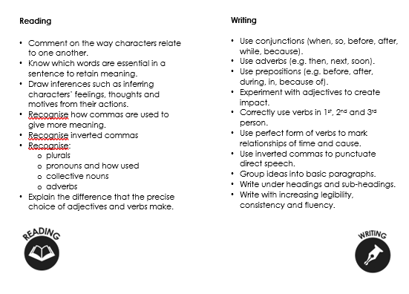
Year 3 / end of year expectations

Slide 12
Thank you for LISTENING to year 3 meet the teacher
Please get in touch via. the office with any questions, queries or to discuss your child’s needs.

